Slide 1
Report launch
Using Citizen-Generated Data to Address Drug Resistant Infections in Kenya
PHOTO CAPTION + CREDIT

Slide 2
1
Welcome remarks
2
Presentation of findings
3
Keynote speech
4
Panel discussion
5
Q&A
6
Closing remarks

Slide 3
Opening remarks
Samuel Kimeu
Executive Director,
Africa’s Voices Foundation

Slide 5
Join at slido.com #954271
ⓘ Start presenting to display the joining instructions on this slide.
Notes:
📣 This is Slido interaction slide, please don't delete it. ✅ Click on 'Present with Slido' and the joining instructions will appear when you get to this slide.

Slide 6
What is the first word that comes to mind when you think of AMR?
ⓘ Start presenting to display the poll results on this slide.
Notes:
📣 This is Slido interaction slide, please don't delete it. ✅ Click on 'Present with Slido' and the poll will launch automatically when you get to this slide.

Slide 7
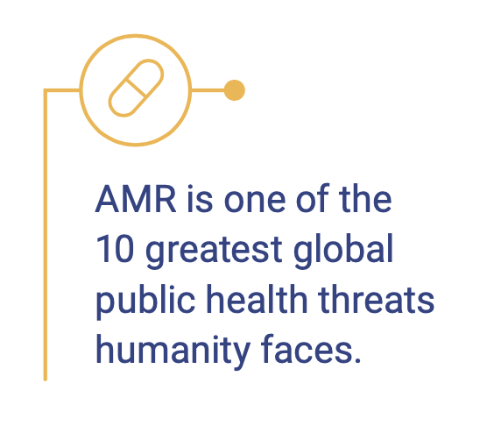
AMR is a global problem
and
It is also a data challenge
By 2030, antimicrobial resistance could force up to
24 million people
into extreme poverty.
At least 700,000 people
die every year due to drug resistant infections. infections.
Notes:
Yet data on AMR is lacking, which limits our understanding of its burden or to communicate its urgency.
To tackle this challenge, the Global Antimicrobial Resistance and Use Surveillance System (GLASS) was launched in 2015. GLASS collects official national AMR data primarily through surveillance systems.
As countries strengthen surveillance data systems complementary approaches are urgently needed to generate quality data on AMR.

Slide 8
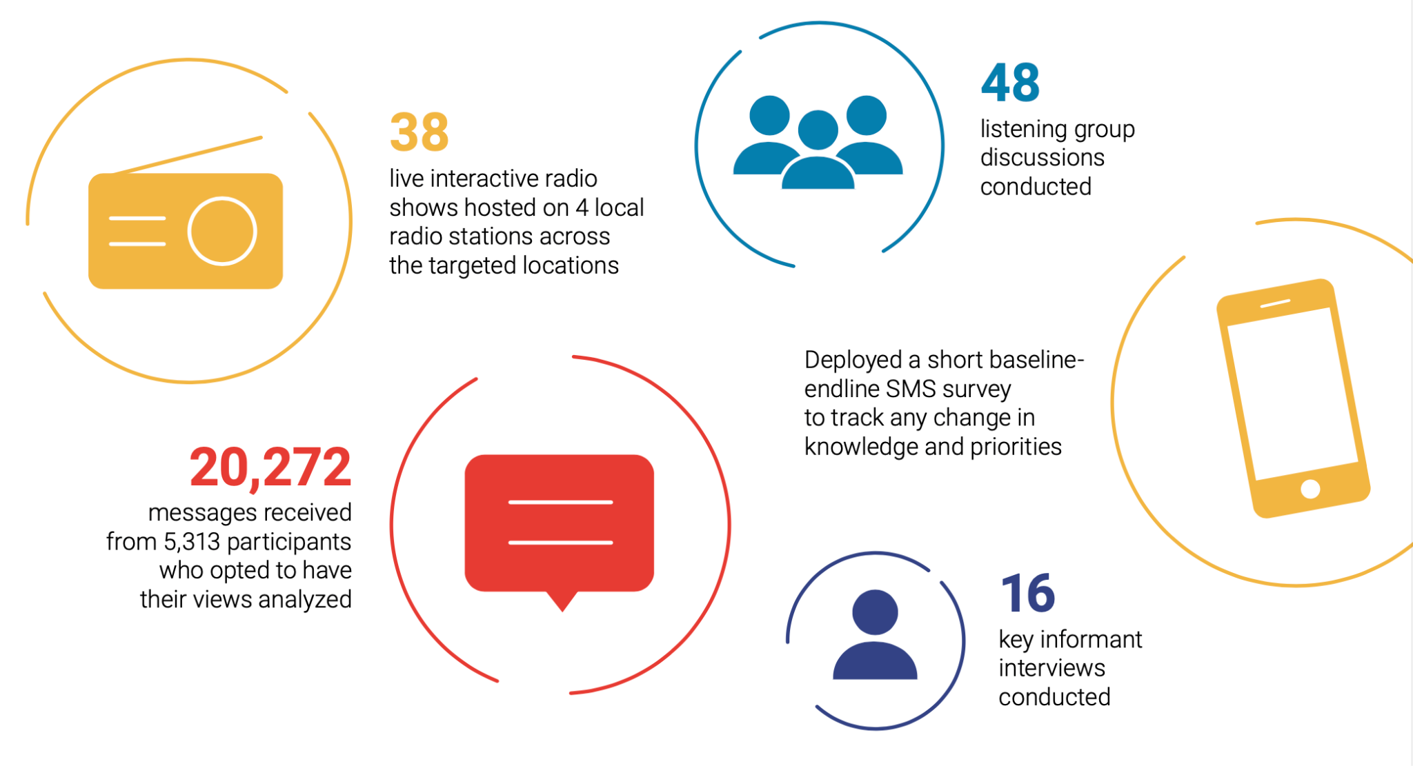
Methodology

Slide 9
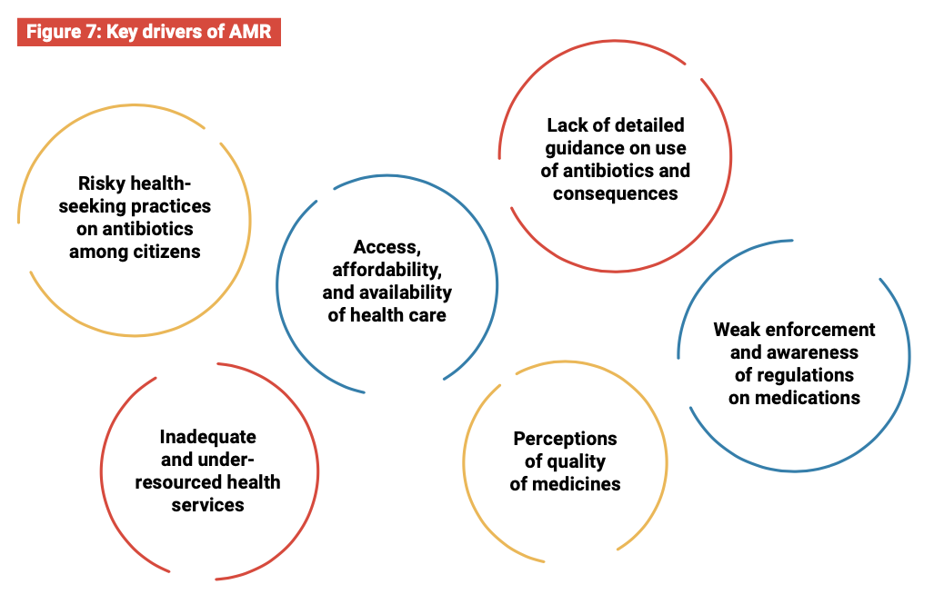
Findings
Tackling AMR is a shared responsibility:
Citizens’ should change their practices in accessing, using, and misusing antimicrobials.
Investment in AMR is a public health priority. Policymakers should embrace CGD.
Driving quality patient engagement on AMR to tackle misinformation and improve levels of trust with citizens.
Incorporating citizens’ voices in research studies that target challenges on AMR.
Key drivers of AMR

Slide 10
Dr. Simon Kibias
Ministry of Health
Ag Head Directorate of Health Standards, Quality Assurance and Regulation, Kenya Ministry of Health

Slide 11
Dr. Rashid Aman
Ministry of Health
Health Chief Administrative Secretary,
Kenya Ministry of Health

Slide 12
Panel discussion
Moderated by Dr. Janet Midega, Wellcome Trust
Dr. Evelyn Wesangula, Head, National Patient and Health Worker Safety Division, Ministry of Health
Benjamin Avusevwa, Director Statistical Coordination and Methods, Kenya National Bureau of Statistics
Dr. Sam Akech, Principal Investigator, Health Services Unit, KEMRI-Wellcome Trust

Slide 13
Questions?

Slide 14
Closing remarks
Prof. Sam Kariuki
Ag. Director General,
Kenya Medical Research Institute

Slide 17
For questions, contact kbett@data4sdgs.org
Visit data4sdgs.org for more information.

